Slide 1

Warby Parker
Learn SQL from Scratch
Patrick Sumpter
17JUL2018

Slide 2
Get to Know Warby Parker:
Table Of Contents
Quiz Funnel
2. Home Try-On Funnel
3. Insights

Slide 3
Get To Know Warby Parker
1. Quiz Funnel

Slide 4
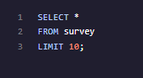
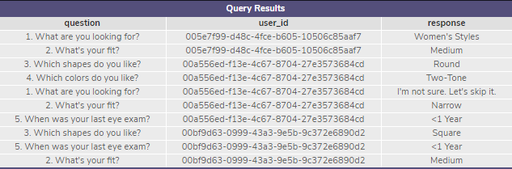
1.Q1
Get To Know Warby Parker
Quiz Funnel: Survey
Q1: I was tasked to “Select all columns from the first 10 rows”
Query
Results
Q1.1: I was also asked “What columns does the table have?”
There are 3 columns
Question
User_id
Response

Slide 5
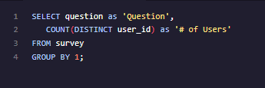
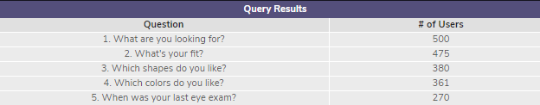
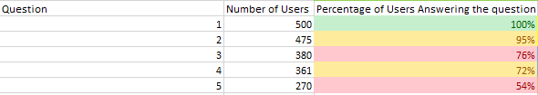
1.Q2
Get To Know Warby Parker
Quiz Funnel: Answers
Q2: I was then tasked to “Create a quiz funnel using the GROUP BY command
Query
Results
I was then asked the following questions about the results:
Q2.1: Which question of the quiz has a lower completion rate?
Q2.2: What do you think the reason is ?
Q2.1:
Question 3 had the lowest completion by users that answered the previous question, with question 5 close behind.
Q2.2:
I believe that question 3 is an uncommon question due to people not having previous knowledge of common glasses shapes as they do color and fit.
I believe that question 5 is totally different than any other question on the quiz due to its irrelevance, 1-4 are opinion of taste, where 5 is looking for a factual answer.

Slide 6
Get To Know Warby Parker
2.Home Try-On Funnel

Slide 7
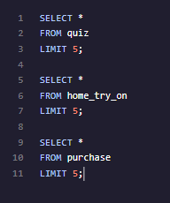
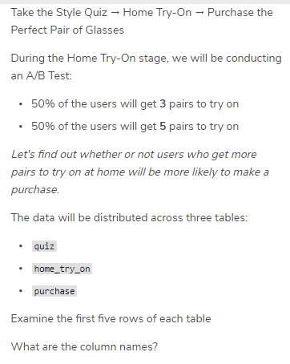
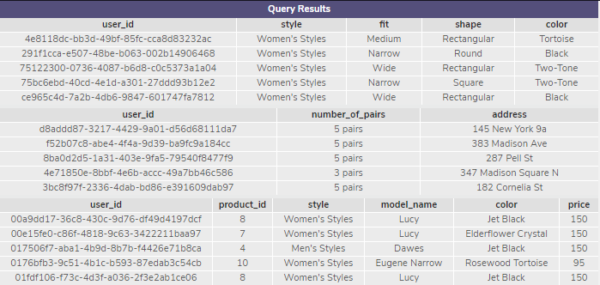
2.Q1
Get To Know Warby Parker
My Task At Hand
H.T.O.F: Purchase Funnel
Query
Results
Q1
Q1.1

Slide 8
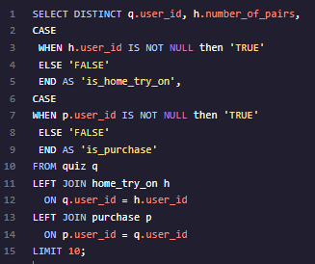
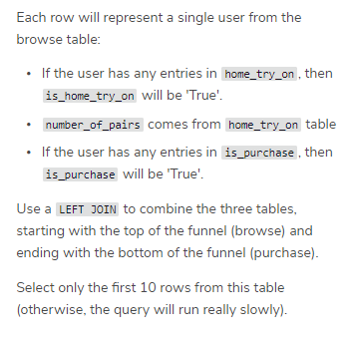
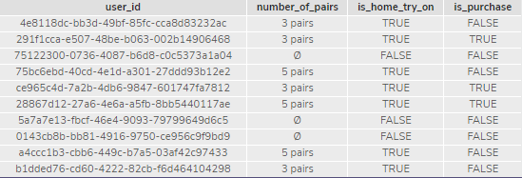
2.Q2
Get To Know Warby Parker
My Task At Hand
H.T.O.F: Explore
Query
Results
Q2

Slide 9
Get To Know Warby Parker
3.Insights

Slide 10
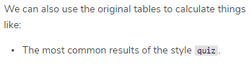
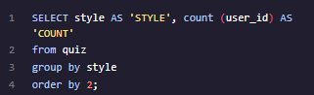
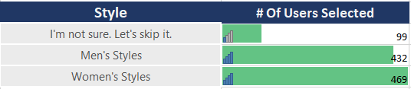
Get To Know Warby Parker
My Task at hand
Insight
Query
Results

Slide 11
Get To Know Warby Parker
Thank You!

